Slide 1
Al-Powered Electrical Safety Monitoring System

Slide 2
PROBLEM STATEMENT
Electrical faults are a major cause of fires.
Traditional systems react only danger occurs.
Manual inspections are time-consuming and unreliable.
Early prediction can prevent accidents and property damage.

Slide 3
OBJECTIVES
Identify abnormal electrical conditions.
Monitor voltage continuously using sensors.
Predict potential fire risks using intelligent analysis.
Provide early alerts to users and maintenance teams.

Slide 4
EXISTING SYSTEM
Smoke detectors detect fire after it starts.
Temperature sensors respond only to heat increase.
Regular inspections require human intervention.
Existing systems focus on detection rather than prevention.

Slide 5
PROPOSED SYSTEM
Continuously monitors voltage levels.
Detects abnormal fluctuations in electrical supply.
Calculates risk levels based on sensor data.
Alerts users before hazardous conditions develop.

Slide 6
SYSTEM ARCHITECTURE
Voltage Sensor collects electrical data.
Arduino Uno processes sensor readings.
Python backend analyses and stores information.
Dashboard displays risk status and alerts.

Slide 7
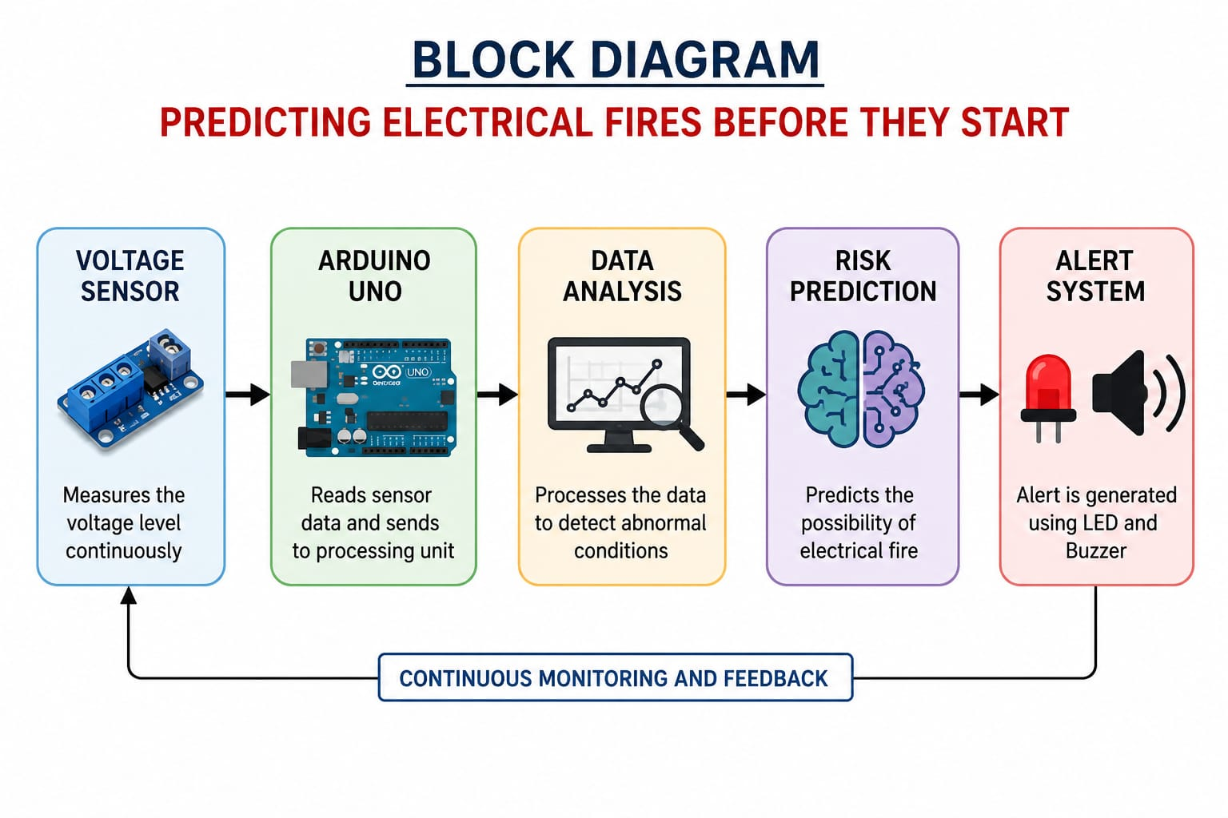
BLOCK DIAGRAM

Slide 8
WORKING METHODOLOGY
Sensor measures real-time voltage values.
Arduino sends data to the processing system.
Risk score is generated from voltage readings.
Alert is displayed when risk exceeds threshold.

Slide 9
APPLICATIONS
Residential electrical safety systems.
School and college laboratory monitoring.
Industrial equipment protection.
Electrical infrastructure surveillance.

Slide 10
FUTURE ENHANCEMENTS
Integration of temperature sensors.
Addition of current monitoring modules.
Machine learning-based risk prediction.
Mobile application with instant notifications.

Slide 11
CONCLUSION
Provides proactive electrical fire prevention.
Improves safety through continuous monitoring.
Offers cost-effective and scalable implementation.
Contributes to safer and smarter environments.

Slide 12
THANK YOU

